Slide 1

Overview of Porter Freight Funding
Sales Training 2025

Slide 2
Topics Covered:
Factoring Products
Recourse / Non-Recourse
Once a Carrier Becomes a Client
NOA / BOL / POD
Funding Options
PorterWallet (Tank)
ACH
Wire
Fuel Cards
Key Benefits of Factoring
Contract key terms
Competitive Differentiators
Overview of Fuel Cards
Fuel Advances

Slide 3
Factoring products
Recourse: Client is responsible for unpaid invoices after 90 days (industry average is 72 days, so this is an advantage for Porter).
Non-Recourse: Porter assumes the risk of non-payment in the event of a bankruptcy from the debtor.
Except under PERFORMANCE ISSUES:
Paperwork
OSD (Over, Short, Damaged)
Claims
Unreported Advance
Lumpers
Reserve: an amount held in reserve to cover “chargebacks” so that operations isn’t disrupted (highly encouraged)
Notes:
In freight factoring, a "reserve" is essentially a portion of the invoice value that the factoring company temporarily holds back. This is done to mitigate risks like non-payment, invoice disputes, or other unforeseen issues that could arise before the customer fully pays the invoice.
Here's a visual explanation using an analogy:
Imagine a bank holding a security deposit
Think of the reserve in freight factoring like a security deposit when renting an apartment.
When a trucking company "sells" an invoice (representing a completed shipment) to a factoring company, they get an immediate advance on most of that money (like getting keys to the apartment and moving in).
However, the factoring company holds back a small portion (the reserve), just like a landlord holds a security deposit.
If everything goes smoothly and the customer pays the invoice in full and on time (like the tenant leaving the apartment in good condition), the factoring company releases the reserve amount back to the trucking company, minus any factoring fees.
Visualizing the process
Trucking Company Delivers Load: Imagine a truck driver completing a delivery and getting a signed Bill of Lading (proof of delivery).
Invoice Generated: The trucking company creates an invoice for the completed delivery.
Invoice Sold to Factor: Instead of waiting for the customer to pay the invoice (which can take weeks or months), the trucking company sells the invoice to a factoring company.
Initial Advance: The factoring company provides an immediate advance to the trucking company, typically 90-95% of the invoice value.
Reserve Held: The remaining 5-10% is held by the factoring company as a reserve.
Customer Pays Factor: The customer eventually pays the full invoice amount to the factoring company.
Reserve Release (Minus Fees): Once the factoring company receives payment from the customer, they release the reserve amount to the trucking company, minus any factoring fees.
In essence, the reserve acts as a safety net for the factoring company, protecting them from potential losses while still providing the trucking company with much-needed immediate cash flow.

Slide 4
Once Carrier becomes a Porter Client
Client managed by the ONBOARDING Team for the first 30 days
Send out Welcome Email
Teach them about NOA’s; how to submit invoices; reporting; etc.
PorterGo App
Submit invoices
Fuel Route options
Request Fuel Advances
Overview of AR (Total AR), Reserve Amount
Invoice Aging
Porter Portal
Transitioned to AE (team) after 30 days
Notes:
What Is A Bill Of Lading?
A Bill of Lading is a document issued by a carrier to a shipper, confirming receipt of goods in acceptable condition for shipment. It serves as a contract of carriage between the shipper, carrier, and consignee, outlining the terms for delivering the goods to the consignee.
What Are Bill of Ladings Used For?
A bill of lading meaning can represent a receipt of goods.
Shipments cannot be executed without a Bill of Lading. BoLs must be issued for goods to travel from Point A to Point B. They are legally binding documents, and they often serve as proof of ownership over the goods being carried.
A bill of lading also covers its role as the title to goods.
Once the goods have arrived at their destination, the Bill of Lading acts as a title to the goods. The consignee* listed will need to present the Bill of Lading in order to secure the release of the shipment by the carrier and claim ownership. In this sense, it is evidence of the confirmation of delivery.
*Only the consignee listed on the Bill of Lading has contractual rights to request for the release of the cargo.
Bills of lading also make sure that the shipper is paid
In some cases, the shipper can hold the original bill until they receive payment. By doing this, the consignee is unable to access their goods until payment has been made and the Bill of Lading released.
Who Uses A Bill Of Lading?
Usually, all companies that sell transportation services generate bills of lading. They can include owner-drivers, freight forwarders, steamship lines, third-party logistics companies and others. They include companies transporting goods by any means, whether it be through air, sea, rail or road.
They can be used for both domestic and international deliveries.
What Is Contained In A Bill Of Lading?
Details of the transportation company (i.e. the carrier), the shipper and/or consignee;
The place where the goods were loaded;
Destination;
Transportation mode (i.e. road, rail, air, sea, etc.);
The terms of the shipment (incoterms); and
A description of the goods being carried (including their weight, dimensions, classification, etc).
Accuracy Is Critical
We cannot stress the importance of providing accurate information on a Bill of Lading.
Mistakes in preparing bills of lading have led to disasters for transportation companies. For example, in 2017, a freight forwarder was ordered by a court in NSW to pay over $800,000 in damages for ‘misleading and deceptive conduct’ because the bills of lading gave the impression that they were ocean carriers’ bills (when they were not).
Extreme caution must be taken when generating these bills.
Who Issues A Bill Of Lading?
The ‘Carrier’ is the only company that can issue the Bill of Lading. When transporting by sea freight, the carrier can refer to the Shipping Line (Vessel Operating Common Carrier) or an NVOCC (Non-Vessel Operating Common Carrier) also known as a Freight Forwarder (although not all Freight Forwarders are NVOCC’s).
Who Receives A Bill Of Lading?
Bills of lading are normally provided to:
The shipper;
A broker, freight forwarder or a third party managing customs; and
The consignee – this is the person who purchased the goods in the first place.
As a bill of lading example: if the goods are being imported through a freight forwarder on EXW terms (refer to incoterms again), this is the journey of a Bill of Lading:

Slide 5
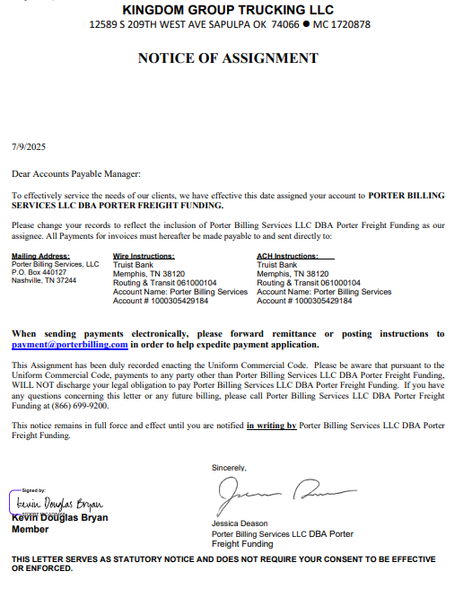
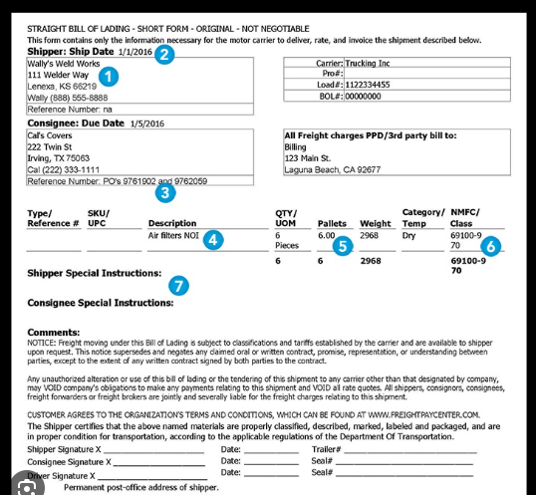
Once Carrier becomes a Porter Client
We send out NOA (Notice of Assignment)
Client hauls load and sends us BOL (Bill of Lading) and POD (Proof of Delivery)
NOTE: BOL must be signed to become POD
Notes:
What Is A Bill Of Lading?
A Bill of Lading is a document issued by a carrier to a shipper, confirming receipt of goods in acceptable condition for shipment. It serves as a contract of carriage between the shipper, carrier, and consignee, outlining the terms for delivering the goods to the consignee.
What Are Bill of Ladings Used For?
A bill of lading meaning can represent a receipt of goods.
Shipments cannot be executed without a Bill of Lading. BoLs must be issued for goods to travel from Point A to Point B. They are legally binding documents, and they often serve as proof of ownership over the goods being carried.
A bill of lading also covers its role as the title to goods.
Once the goods have arrived at their destination, the Bill of Lading acts as a title to the goods. The consignee* listed will need to present the Bill of Lading in order to secure the release of the shipment by the carrier and claim ownership. In this sense, it is evidence of the confirmation of delivery.
*Only the consignee listed on the Bill of Lading has contractual rights to request for the release of the cargo.
Bills of lading also make sure that the shipper is paid
In some cases, the shipper can hold the original bill until they receive payment. By doing this, the consignee is unable to access their goods until payment has been made and the Bill of Lading released.
Who Uses A Bill Of Lading?
Usually, all companies that sell transportation services generate bills of lading. They can include owner-drivers, freight forwarders, steamship lines, third-party logistics companies and others. They include companies transporting goods by any means, whether it be through air, sea, rail or road.
They can be used for both domestic and international deliveries.
What Is Contained In A Bill Of Lading?
Details of the transportation company (i.e. the carrier), the shipper and/or consignee;
The place where the goods were loaded;
Destination;
Transportation mode (i.e. road, rail, air, sea, etc.);
The terms of the shipment (incoterms); and
A description of the goods being carried (including their weight, dimensions, classification, etc).
Accuracy Is Critical
We cannot stress the importance of providing accurate information on a Bill of Lading.
Mistakes in preparing bills of lading have led to disasters for transportation companies. For example, in 2017, a freight forwarder was ordered by a court in NSW to pay over $800,000 in damages for ‘misleading and deceptive conduct’ because the bills of lading gave the impression that they were ocean carriers’ bills (when they were not).
Extreme caution must be taken when generating these bills.
Who Issues A Bill Of Lading?
The ‘Carrier’ is the only company that can issue the Bill of Lading. When transporting by sea freight, the carrier can refer to the Shipping Line (Vessel Operating Common Carrier) or an NVOCC (Non-Vessel Operating Common Carrier) also known as a Freight Forwarder (although not all Freight Forwarders are NVOCC’s).
Who Receives A Bill Of Lading?
Bills of lading are normally provided to:
The shipper;
A broker, freight forwarder or a third party managing customs; and
The consignee – this is the person who purchased the goods in the first place.
As a bill of lading example: if the goods are being imported through a freight forwarder on EXW terms (refer to incoterms again), this is the journey of a Bill of Lading:

Slide 6

Verification of Invoices
All invoices for all new clients will be verified until the debtor pays the invoice
Our team reaches out to each debtor for each invoice for validation
Once a debtor pays an invoice then we no longer need to verify all invoices
Once debtor pays; random invoices verified
Carrier adds a new debtor these also then get verified until first invoice paid
Once invoice is verified we are ready to FUND

Slide 7
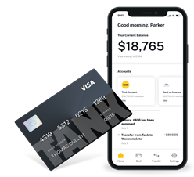
Funding methods
PorterWallet (Tank): An electronic bank account that provides the cheapest, quickest method of funding. Using the physical debit card and/or apple wallet they can keep money in the account and utilize to spend while on the road.
Set up auto-payments for trucks, utilities, house, etc.
Push funds instantly to PorterFuel card
Push to OTHER bank accounts
Funding after hours; on weekends and some holidays

Slide 8
Funding methods
Automated Clearing House (ACH): traditional bank process which will provide access to funds within one to two business days. Funding documents must be submitted by 11:00 cst to have funds pushed same day to federal reserve. This process takes longer because it’s in essence a paperless check and funds must clear before the bank applies them to accounts.
Wire: traditional bank process that is considered “collected funds” therefore is available within one to two hours of processing (larger banks may process quicker.) Some banks charge to send and to receive.

Slide 9
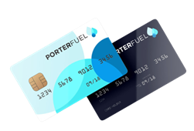
Funding methods
PorterFuel Card: Porter offers an over-the-road (OTR) fuel card that allows fleets to purchase fuel at the cash price at truckstops and fueling locations across the nation. We can apply a set portion of all fundings ($ and/or %) towards the fuel account allowing them always have fueling funds available.

Slide 10
Key Benefits of Factoring:
Immediate Cash Flow: Get paid within 24 hours on approved invoices — no more waiting 30+ days for brokers to pay.
Back-Office Support: We handle invoicing, collections and account resolution so you can focus on running your business.
Credit Protection: We verify broker creditworthiness to help reduce your risk of non-payment.
Flexible Funding Options: With tools like PorterWallet you choose how and when to get paid — giving you more control over fees and timing.
Dedicated Account Executive: No call centers. You get a single point of contact who knows your business.

Slide 11
Key Benefits: contract terms
Clause | What It Means for YOU
Exclusivity | To provide stable funding and manage collections effectively, we ask you to factor all eligible invoices with us during the term.
Termination Notice | You can exit the agreement with a written 60-day notice — this prevents disruption and ensures all invoices are resolved properly. At Porter Freight we want to ensure a smooth transition and not interested in penalty traps.
Reserve | In the event you have an invoice charged back because of a dispute for which you are at fault, a reserve will most likely cover the expense so that your business is NOT disrupted.
Fees | All fees are disclosed up front — no hidden charges. With Porter you have the power of choice, you decide how often and how fast funds are delivered and to where the funds go. You can fund multiple accounts, multiple ways; associated funding fees are direct, clear and simple. Additionally, the fee outlined on the Schedule A is the fee you pay for each and every invoice each month. No conditional criteria that drives your rates up based on prior month's usage; unless you specifically want this type of arrangement.
UCC Filing | For our own compliance needs we will be filing a UCC Filing Statement with your state of domicile. The purpose of this filing is to ensure that the invoices sold to us belong to us entirely with no other encroachments by anyone else.
Clause | What It Means for YOU
Exclusivity | To provide stable funding and manage collections effectively, we ask you to factor all eligible invoices with us during the term.
Termination Notice | You can exit the agreement with a written 60-day notice — this prevents disruption and ensures all invoices are resolved properly. At Porter Freight we want to ensure a smooth transition and not interested in penalty traps.
Reserve | In the event you have an invoice charged back because of a dispute for which you are at fault, a reserve will most likely cover the expense so that you business is NOT disrupted.
Fees | All fees are disclosed up front — no hidden charges. With Porter you have the power of choice, you decide how often and how fast funds are delivered and to where the funds go. You can fund multiple accounts, multiple ways; associated funding fees are direct, clear and simple. Additionally the fee outlined on the Schedule A is the fee you pay for each and every invoice each month. No conditional criteria that drives your rates up based on prior month's usage; unless you specifically want this type of arrangement.
UCC Filing | For our own compliance needs we will be filing a UCC Filing Statement with your state of domicile. The purpose of this filing is to ensure that the invoices sold to us belong to us entirely with no other encroachments by anyone else.

Slide 12
Competitive Differentiators:
Chargebacks only after 90 days of collection efforts
Account Resolution Team goes to work on day 91 retrieving 80% in all monies owed for the past year.
No TERMINATION FEE if you’ve given the required 60 days notice in writing.
We pride ourselves in taking your phone calls with live team members that know you and your business.
Creative and flexible funding options; that are fast and cheap.
Flat rates that are REALLY flat (no hidden dynamic pricing in contracts)!

Slide 13
Who we don’t do business with:
Vehicle types
HOTSHOT: Autohaulers
Livestock
Most “raw materials”
Companies based in:
Alaska or Hawaii (or any of the US Territories)
California
Canada
Amazon Direct

Slide 14
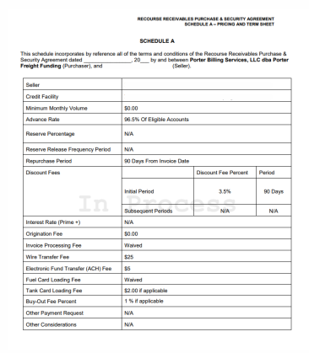
Items we need to get a prospect started:
Factoring Application
Factoring Contract
COI (Certificate of Insurance) must include VIN #’s
Driver’s License (doesn’t have to be a CDL)
Aging Report (not mandatory)
All terms will be laid out on the Schedule A

Slide 15
Fuel Cards
PorterFuel Card: Porter offers an over-the-road (OTR) fuel card that allows fleets to purchase fuel at the cash price at truckstops and fueling locations across the nation.
Accepted at thousands of fueling locations across the nation
Porter negotiated discounts at nearly 2000 locations
We have a MasterCard option for T&E needs
Reference the fuel flyer for average discounts

Slide 16
Fuel Advances
Fuel Advances: Porter offers up to 50% of the load rate up to a maximum of $3500.00 providing the client access to cash to offset some of their business expenses.
Funding via PorterWallet (Tank); PorterFuel Card; ACH and/or Wire*
Advances via ACH or wire must be submitted by 3pm cst M-F; PorterWallet (Tank) and PorterFuel Card advances can be submitted M-F 7am – 9pm; Weekends and Holidays we work from 8am – 8pm
To receive an advance, carriers must submit the rate confirmation and shipper signed BOL showing the load is picked up.
Fuel Advances are entered into the system and automatically deducted from funding amounts upon invoice submission
Advances can we submitted via the PorterGo app or this link: https://www.porterfreightfunding.com/fuel-advance-application/
*NOTE: Wire fees will be charged if funding via Wire.

